Slide 1
Innovate UK, Opportunities & Networks
Chris Sawyer – Lead Technologist – Health & Lifesciences

Slide 2
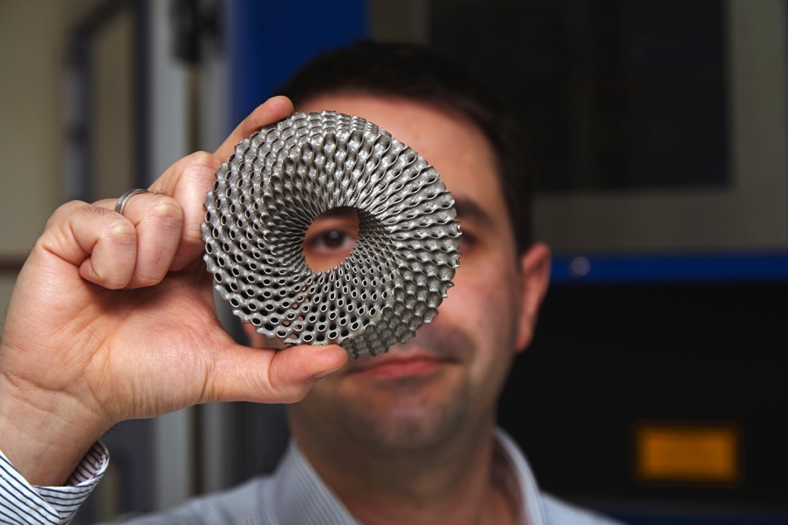

Innovation is the key driver of productivity
Innovation contributes up to 50% of all labour productivity growth
Firms that persistently invest in R&D have:
  Higher productivity (13% higher than those who don’t invest at all)
  Better value-added per employee
  More exports
Notes:
Studies have shown that innovation contributes up to 50% of all labour productivity growth.
We know that firms that persistently invest in R&D have higher productivity.
Innovative companies also deliver better value-added per employee and secure more exports of their products and services.

Slide 3
Innovation doesn’t just happen
It happens as a consequence of coordinated collaboration between:
      Business
      Government
      Research
This is where Innovate UK comes in.
We can’t stop
thinking about
the future
Notes:
It is clear that innovation doesn’t just happen.
Strategic collaboration between business, government and research is key.
This is where Innovate UK comes in.

Slide 4
Innovate UK - The UK’s innovation agency
We have a strong track record of driving growth, working with companies to
de-risk, enable and support innovation.
It’s our vision to help the UK economy grow head and shoulders above other nations by inspiring and supporting pioneering UK businesses to create the industries of the future.
We can’t stop
thinking about
the future
Notes:
Innovate UK is the UK Innovation Agency. We work with people, companies and partner organisations to find and drive the science and technology innovations that will grow the UK economy.
With a strong business focus, we drive growth by working with companies to de-risk, enable and support innovation.
It’s our vision to help the UK economy grow head and shoulders above other nations by inspiring and supporting pioneering UK businesses to create the industries of the future.

Slide 5
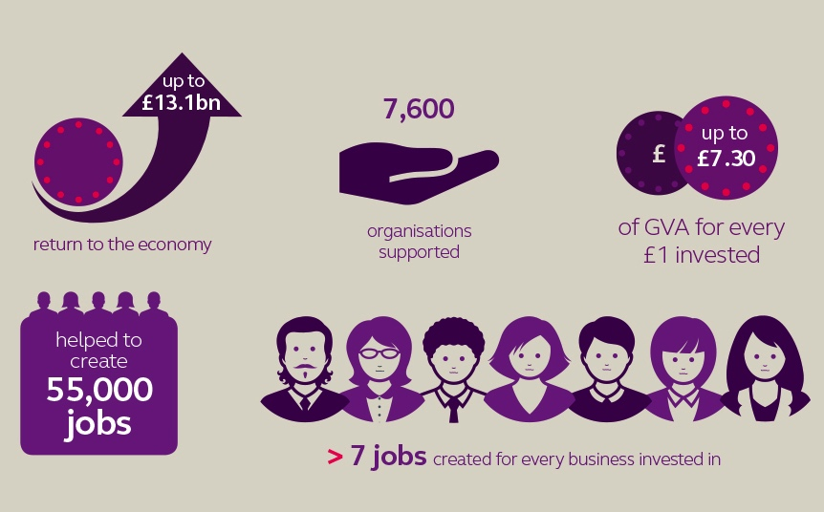
Notes:
These are brand new impact metrics from Innovate UK, we are always analysing how we are delivering impact back to the UK economy and society in general.
Since Innovate UK was created in 2007, we have supported 7,600 organisations through our fund and connect activities.
For every £1 of funding invested through Innovate UK, up to £7.30 of gross value added is returned – this amounts to around £13.1 billion being returned to the UK economy.
In the companies we have supported, an average of just over 7 jobs have been created for every business we have invested in – a total of 55,000 new jobs – a massive driver in supporting the aspirations of UK business.

Slide 6

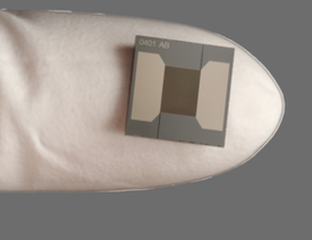

A new phase for supporting UK innovation
New Spending Review period: 2016-2020
National Innovation Plan in 2016
New Innovate UK strategy for next four years
Delivery Plan: what are we doing this year?
Innovate UK becomes part of UK Research and Innovation (UKRI) – Subject to parliamentary approval April 2018
Notes:
We are at the start of a new Spending Review period, 2016-20
As we all know, the government plans to publish a National Innovation Plan later this year. Innovate UK’s new strategy which is currently under development will be strongly aligned to this. Our strategy will describe our aims over the next four years.
We published our Delivery Plan a few months ago. This explains what we are doing in the first year of this new phase, within the financial year 2016/17.
Subject to parliamentary approval in 2018 Innovate UK will become part of UK Research and Innovation alongside the Research Councils.

Slide 7

Our 5-point plan
Working with the research community and across Government to turn scientific excellence into economic impact
Accelerating UK economic growth, nurturing small, high-growth companies, with strong productivity and export success
Evolving our funding models; helping public funding go further
Developing Catapults within a national innovation network
Building on innovation excellence throughout the UK, investing locally in areas of strength
1
2
3
4
5
Notes:
As part of our delivery plan we have a 5 point plan.

Slide 8
What’s changing?
Simpler sector groups
Simpler and broader funding competitions
Enhanced innovation networks - nationally and regionally
Pilots for new innovation finance products
New online competition applications system
But – our commitment to supporting the growth of UK businesses is as strong as ever.
Notes:
So what’s changing at Innovate UK. We are:
aligning our programmes into new simpler sector groups which are easier for business, government and research to align to
changing our sector funding competitions to be simpler and broader in scope
enhancing our innovation networks - nationally and regionally – to provide a better service for business
Developing and piloting competitions for new innovation finance products – beyond simply grants
Introducing a new online competition applications system – the Innovation Funding Service.

Slide 9




Sector focus to accelerate growth
Emerging and Enabling Technologies
  Identifying and investing in technologies and capabilities that will lead to the new products, processes and services of tomorrow
Health and Life Sciences
  Focused on agriculture and food and healthcare, underpinned by bioscience and medical research and enabled by engineering and physical sciences
Infrastructure Systems
  Optimising transport and energy systems and integrating them with other systems such as health and digital
Manufacturing and Materials
  Advancing manufacturing readiness so R&D and technology
  developments increase productivity and capture value in the UK
Notes:
We have formed four sector groups to align our approach more closely with the work of research business and Government.

Slide 10




Funding – Simpler competitions
Two competitions for funding in each sector group this year
Each open to a much wider range of applications
Two ‘open’ rounds per year - for applications from any technology area or sector.
Competitions delivered in partnership with other organisations
Notes:
We have made our competitions much simpler. We were running anything up to 100 competitions a year. Companies have told us that this was difficult to navigate.
There will be two broad competitions for funding in each sector group this year; each open to a much wider range of applications than previously.
There will be an ‘open’ funding programme – with two rounds per year - for applications from any technology area or sector. The open strand includes a Knowledge Transfer programme (KTP).
There will also be competitions and programmes run in partnership with other public sector organisations.

Slide 11

Health and Life Sciences
Two broad competitions per year
Other competitions
Catapults
  Cell and Gene Therapy Catapult –
  new Manufacturing Centre
  New Precision Medicine and
  Medicines Discovery Catapults
Agri-tech Centres
Notes:
This year we will:
Run two broad Health and Life Sciences competitions
Run competitions aligned to new technologies for manufacturing cell therapy products
Continue to fund the Cell and Gene Therapy Catapult
Aim to complete the Cell and Gene Therapy Catapult Manufacturing Centre in Stevenage
Complete the establishment of the Precision Medicine and Medicines Discovery Catapults
Open the new Precision Medicine Catapult headquarters in Cambridge
Continue funding the agri-tech centres as part of industrial

Slide 12
Competition schedule for FY16/17
Competition | Type | A | M | J | J | A | S | O | N | D | J | F | M
Mfg & Materials Rd1 | Grant
Mfg & Materials Rd2 | Grant
Open Rd1 | Grant
Open Rd2 | Grant
Infrastructure Systems Rd1 | Grant
Infrastructure Systems Rd2 | Grant
Health & Life Science Rd1 | Grant
Health & Life Science Rd2 | Grant
Emerging & Enabling Rd1 | Grant
Emerging & Enabling Rd2 | Grant
Open
Assess
Open
Assess
Open
Assess
Open
Assess
Open
Assess
Open
Assess
Open
Assess
Open
Assess
Open
Assess
Open
Assess
We will also run competitions in partnership with other organisations.
For all competitions see the Delivery Plan or www.innovateuk.gov.uk
Notes:
Each Sector Group will have:
Two competitions a year (one every six months)
All competitions to be single stage
Each competition covers all the prioritised topics within a Sector Group
Strategies will be implemented by funding Portfolio
Sector Group provides advance notice of intent to applicants
Moving into the new simplified competition structure:
Predictable, regular, continuous competitions much easier to bid into
Catalysts would sit alongside new simplified structure (if funded by fiscal events)
Smart is accommodated into the new simplified structure (Open)
Structure ready for the introduction of New Innovation Finance Products (NIFPs)

Slide 13

Evolving our funding models - New innovation finance products
Different businesses at different stages need different support
Range of products beyond grants
We’re evolving our range of products, working with the Department of Business, Innovation and Skills
Three pilot competitions planned this year
Notes:
We know that businesses at different stages of their development can benefit best from different forms of innovation support.
Working with you all, we are preparing to widen our range of products beyond grants in future.
Later this year we will run three pilot competitions for new innovation finance products.

Slide 14

Connecting – Strengthening our networks
Linking businesses with academics, government, partners and funding.
Guiding and helping businesses navigate all the support opportunities that exist.
The Knowledge Transfer Network (KTN) and Enterprise Europe Network (EEN) help companies nationally and regionally.
Introduction of Innovate UK Regional Managers
Notes:
We help businesses grow by connecting: linking them with academics, government, new partners and funding opportunities.
We provide direct guidance and help business navigate all the support opportunities that exist.
This year we will build support through the Knowledge Transfer Network (KTN) and Enterprise Europe Network (EEN), helping innovative businesses nationally and regionally.
We have also recently introduced Innovate UK regional managers to support regional activity.

Slide 15

Europe and International
Within Europe
  Horizon 2020 programme
Beyond Europe
  Relationships with other countries
Newton Fund
Two entrepreneur missions overseas
Notes:
We have a focus on working within Europe and internationally, and supporting UK businesses in making these connections.
This year we will:
Continue business participation in the Horizon 2020 programme
Increase opportunities for UK business through relationships with other countries, including through the Newton Fund
Run 2 entrepreneur missions overseas

Slide 16


Lifestyle ethos, interoperability and scalability
ILIP so Far.....
Knowledge Transfer & Standards
Social innovation, service design
delivering assisted living lifestyles
at scale
£37.3m with NIHR, Scottish Government
Understanding barriers to market
Independence Matters £2m with Design Council
Business Models/Social & Behavioural Studies £12.3m with NIHR, ESRC
Long Term Care Revolution £2.4m / £4m National Challenge
Technology/product development
2011-15
2010-12
Home Based Systems and User Centred Design £14.3m with NIHR, ESRC, EPSRC
2009/10
2007
2008
Ambient Assisted Living
6 calls
Smart Care Distributed Environment £16.2m with NIHR, EPSRC
Notes:
Now before I move on to a new opportunity I would just like to take a few moments to reflect on what we have achieved in the area of assisted living and the context of this meeting. In 2007 we started on the assisted living journey and as you will see have supported a vast number of activities over the years in this area. We have also built a strong network of organisations and individuals across the sector including over 2000 people in our network. As you can see from this chart that we have done a lot since 2007. Talk to slide…….

Slide 17
New Opportunity

Slide 18
Health & Life Sciences Competition
Opened 12th September
Innovate UK is investing up to £15 million in projects addressing technical or commercial challenges in health and life sciences (H&LS). The aim is to increase competitiveness for UK small and medium-sized enterprises (SMEs). The H&LS sector focuses on agriculture, food and healthcare. It is supported by bioscience technology, medical research and engineering and physical sciences expertise.
Competition opens | 12th September 2016
Briefing events for applicants | London 19th September 2016
Registration deadline | Noon 9th November 2016
Application deadline | Noon 16th November 2016

Slide 19
Health & Life Sciences Competition
Eligibility - All UK businesses
Stream 1: Projects with total eligible project costs of up to £100k and 12 months or less in duration: Up to £5m available in total
Stream 2: Projects with total eligible project costs of up to £2 million or between 12 and 36 months in duration. Up to £10m available in total (£5m up to 2 yrs, £5m up to 3 yrs)
Projects of over £100k must be collaborative. Single SME under £100k
Research Organisations cannot receive a total >30% of funding (*>50% clinical trials)
A company may be involved in up to 3 applications but can only lead in one
Funding levels vary by company category – see funding rules
* All projects must involve an SME

Slide 20
Health & Life Sciences Competition
SCOPE
The aim of this competition is to stimulate innovation in H&LS.
Projects must cover at least one of the following Innovate UK priority areas:
Increase yield, quality and sustainability in agricultural food production
Improve precision medicine, advanced therapies, preclinical technologies and biosciences in healthcare
Proposals should indicate how projects will enable a step change in competitiveness and productivity for at least one UK SME involved in the project.

Slide 21
Health & Life Sciences Competition SCOPE
We encourage applications featuring:
Increasing agricultural productivity:,
advanced and precision engineering , fighting agro-chemical and antimicrobial resistance, enhanced resilience to biotic and abiotic stress, individualised livestock/aquaculture nutrition and healthcare, novel genetics and breeding
Improved food quality and sustainability:
authenticity and traceability, enhanced nutritional value, food safety, modern methods of food manufacturing, new and smarter ingredients, protein development , smarter packaging
Precision medicine:
paediatrics and child health, stratification in primary care and the community, including direct-to-consumer products, companion diagnostics, antimicrobial resistance, precision medicine and advanced therapies
Advanced therapies:
preclinical testing and advanced therapies, preparation and execution of early clinical trials, developing tools and technologies that help new therapies launch in the health sector
Preclinical technologies:
developing and validating new in silico, in vitro and in vivo medicines testing before human trials, techniques to improve success and safety in drug discovery , approaches relevant to the agrichemical, chemical and personal care industries
Biosciences:
synthetic biology, computational systems biology, characterisation and discovery tools, bio-based and sustainable solutions

Slide 22
Health & Life Sciences Competition OUT OF SCOPE
Increasing agricultural productivity:
projects on forestry, horses or wild fisheries
Improved food quality and sustainability:
food processing or manufacturing applications that focus solely on improvements in production efficiency will not be considered. However, these areas may find potential opportunities in future manufacturing and materials competitions
projects with a primary focus on a health claim (as opposed to a nutrition claim), that would require approval from the European Food Safety Authority
Precision medicine:
diagnostic tests that do not result in patient stratification
diagnostic tests for treatments that are still in development
biomarker discovery experiments
Advanced therapies:
discovery of a new advanced therapy
large-scale manufacture of cell and gene therapies
advanced therapies specifically for non-human use
Preclinical technologies:
extensive validation studies for licensed regulatory bodies
discovering or developing a new medicine
Biosciences:
a technology that could only be used for a single medical, agricultural or food production application – for example, production of a specific biopharmaceutical
management and use of biofilms I think ‘scaling up’ to ‘large-scale’ manufacture really means the same thing – large-scale manufacture. Please check my suggestion to delete ‘scale-up’.

Slide 23
Networks

Slide 24
Considerations
Purpose, Goals and Objectives
Scope & Profile
Members and Partners
Communication Plan
Performance Measures
Key Success Factors
Sustainability
Notes:
Ask yourself this! Why a network in the first place? What is your vision? What are your aspirations? What are your goals and objectives in the near, mid and long-term? Do you have the necessary plans in place to help you achieve your aspirations? I saw that someone spoke previously about a Product Roadmap. I see this, and other planning tools as being crucial in developing a programme of this sort. And document the vision for the network and put those objectives in place, which need to be SMART. Sensible, measurable, achievable, realistic and timely.
Consider the scope. Are you content with a meeting every quarter or are you looking to do something more ambitious? Are your ambitions for the network local, national or international? Once again what do you want to be and what do you want to achieve. But be realistic. You can’t do everything at once and whatever you do want to do will take time. This is where planning is so very important.
And who are your members and partners? Who do you need or want to work with and when to achieve your goals and objectives? And what is their role and why are they important?
And do you have a communication plan. Does your intended audience recognise you and do your stakeholders all understand the overall remit of the network?
And what measures do you need in place to monitor whether you are doing the right things and well.
How will you measure success? What will success look like? How will you know that you have been successful?
And very important, how will you become sustainable, if that is your intention? Or rather, will this be something you want to sustain over a longer period of time? In my mind, it sounds like you are doing some really positive things and surely if this is the case you would want to continue, so it would be very disappointing if you were unable to continue. Over the years we have seen many enterprises that had great potential but were unable to sustain their momentum and ultimately didn’t achieve long-term success. I guess this ties back to your overall objectives and vision for the network. But if you do want to be sustainable over a period of time, how are you going to achieve this?

Slide 25
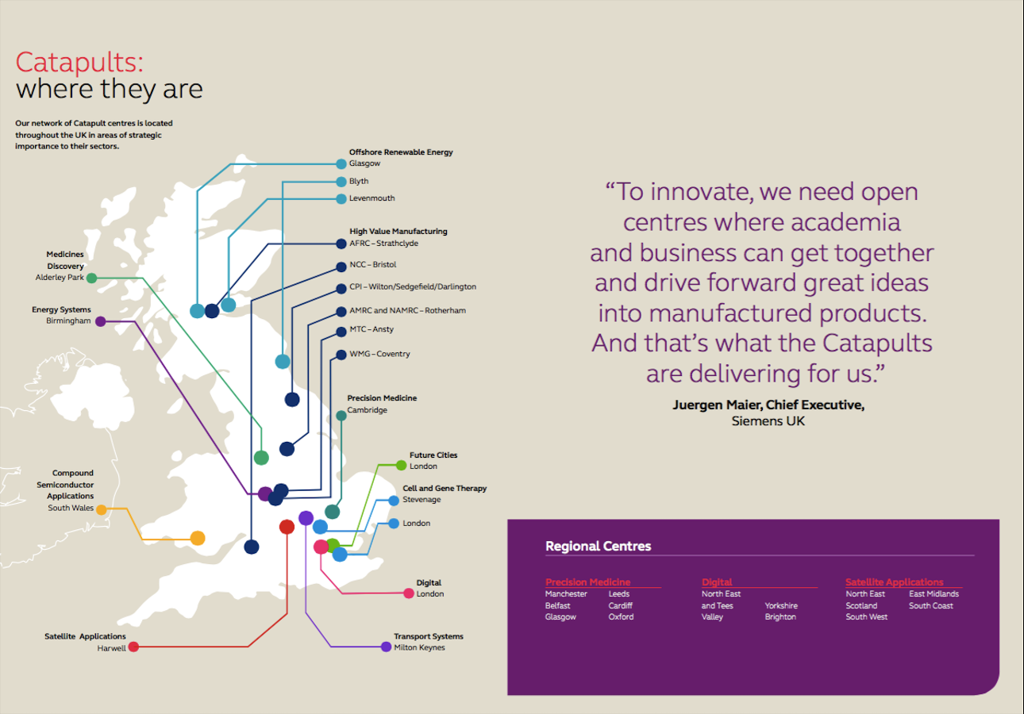
Catapults
Notes:
Catapults are not-for-profit, independent technology and innovation centres set up by Innovate UK. They connect businesses with the UK’s research and academic communities, and help them to access expert help and specialist facilities. There are now 11 Catapults, each focusing on a specific industry. As you will see some of the catapults have built a network within their structure with regional centres, which provides additional support and services to their communities.

Slide 26
DHACA
Not for profit member-driven organisation set-up by Innovate UK
Address key obstacles in the digital health and care market
Broad Membership base
Activities include, Quarterly meetings, SIGs, Influencing Policy & Consultations
Do not currently charge a membership fee
Increasingly influential
Notes:
Digital Health & Care Alliance is a not for profit member-driven organisation set up by Innovate UK as a direct consequence of dallas. Dallas was a large scale demonstrator funded by Innovate UK and stood for delivering assisted living lifestyles at scale.
SME and business focused organisation addressing obstacles in bringing solutions to market such as Information Governance, Economic and Business Modelling and Systems Architecture to name a few
Members include global healthcare companies, NHS Trusts, Local Authorities, SMEs and start-ups.
Activities include quarterly meetings, Special Interest Groups, influencing policy, such as National Information Board, EC Code of Practice for Medical Apps, MHRA and NICE Intervention and the Accelerated Access Review, to name a few.
They do not currently charge a membership fee and are becoming increasingly influential.

Slide 27
Academic Health & Science Networks (AHSN’s)
Membership organisation within the NHS in England
15 designated AHSNs
Aim to collaborate with Health services, academia and industry members.
Purpose: Improve patient outcomes and generate economic benefits.
Focused on projects, programmes and initiatives addressing local challenges
Collaborate across boundaries in order to spread innovation and share best practices.
Core funding from NHSE
Notes:
AHSN’s are membership organisation within NHS England and were formed in May 2013.
In total there are 15 designated AHSN’s in England.
They aim to bring together health, academia and industry in order to improve patient outcomes and generate economic benefit.
Although focused on addressing local issues, there are also strong synergies and collaborations across boundaries to diffuse and spread innovation at scale and share best practices.
Their core funding comes from NHSE

Slide 28
Knowledge Transfer Network (KTN)
The UK’s Innovation Network
Cross-sector organisation
  Defence, aerospece, health, creative industries, built environment, biotechnology, robotics and autonomous systems
Nurture, develop and scale-up innovation within business
A track record of supporting business
  From securing funding
  Business cycle support
Notes:
UK’s Innovation network established by Innovate UK to build better links between science, creativity and business.
It is a cross-sector organisation with specialist teams covering all significant sectors of the economy.
In place to nurture, develop and scale-up innovation within business.

Slide 29
Enterprise Europe Network (EEN)
Worlds largest support network for SME’s with international ambitions
600 member organisations in more than 60 countries
Organisations include commercial and public sector
Expertise across 17 sectors
Services include partnership, advisory and innovation support
Notes:
EEN is a world network organisation looking to support international business.
It has 600 member organisations delivering services in more than 60 countries from both the commercial and public sector
Operating across 17 sectors the EEN provides partnership services through matchmaking and brokerage activities, advisory services, including practical tips on doing business in another country as well as innovation support services including accessing funding and finding the right technology to improve a companies innovation.

Slide 30
TSA
Industry body for Technology Enabled Care
Not for profit fee-based membership organisation
350 membership organisations
Works across health, housing and social care
Main focus is on telecare, telehealth and mHealth
Notes:
TSA was formerly known as Telecare Services Association.
It is a not-for-profit organisation with over 350 fee paying members from across the UK and overseas.

Slide 31
Thanks for listening
Chris Sawyer
Innovation Lead – Health & Lifesciences
Chris.sawyer@innovateuk.gov.uk
Notes:
TSA was formerly known as Telecare Services Association.
It is a not-for-profit organisation with over 350 fee paying members from across the UK and overseas.

